Slide 1


Final Year Project Proposal
Deep Forensics - Multimodal Deepfake Detection System for Bank Video-KYC
Supervised By: Mr. Junaid Khan
Co-Supervisor: Mr. M Imran Khan

Slide 2
Project Team
Sultan (56189)
Ch Mubashir (56892)

Slide 3
Table of Content
Introduction and Background
Literature Review and Summary Table
Gap Analysis
Problem Statement
Proposed Solution & Methodology
Project Scope
Work Breakdown Structure
Roles and Responsibilities

Slide 4
INTRODUCTION AND BACKGROUND

Slide 5
Introduction & Background
Commercial banks and fintech apps now onboard users through remote video calls (Video-KYC).
The State Bank of Pakistan (SBP) encourages digital account opening, making video calls common for identity verification.
The video session serves as the first point of contact for opening accounts or approving high-value transactions.
This reliance on video calls makes remote onboarding an attractive target for digital identity fraud.

Slide 6
Project Stakeholders
Primary Stakeholder: Bank KYC officers and identity verification agents who approve or reject customer applications.
Internal Bank Teams: Fraud, risk management, and IT compliance departments.
End Customers: Legitimate account holders protected from identity theft and fraud.
Regulators: Financial regulatory bodies that require transparent and auditable verification logs.
Secondary Market: Corporate HR departments conducting remote hiring interviews.

Slide 7
LITERATURE REVIEW

Slide 8
Existing Systems – Commercial Solutions
Commercial vendors include platforms like Onfido, iProov, and Jumio.
Cost: Enterprise subscription fees are high, especially for smaller local banks and fintechs.
Closed Systems: Proprietary algorithms operate as black boxes without local source control.
Data Privacy: Data is processed on foreign cloud servers, raising data-residency and compliance concerns under local financial regulations.

Slide 9
References
[1] H. Khalid et al., "FakeAVCeleb: A Novel Audio-Video Multimodal Deepfake Dataset," NeurIPS, 2021.
[2] A. Rössler et al., "FaceForensics++: Learning to Detect Manipulated Facial Images," IEEE/CVF ICCV, 2019.
[3] B. Dolhansky et al., "The Deepfake Detection Challenge (DFDC) Dataset," arXiv:2006.07397, 2020.
[4] A. Haliassos et al., "Lips Don't Lie: A Generalisable and Robust Approach to Face Forgery Detection," IEEE/CVF CVPR, 2021.
[5] T. Mittal et al., "Emotions Don't Lie: An Audio-Visual Deepfake Detection Method Using Affective Cues," ACM MM, 2020.

Slide 10
Gap Analysis

Slide 11
Gap Analysis
Multi-Modal Integration: Lack of simple systems that inspect both face and voice together.
Deployment Control: Lack of self-hosted solutions that allow banks to keep customer biometric data on premises.
Explainability: Existing detection models rarely explain why a frame was flagged.
Compliance Reporting: A missing link between model predictions and official, auditable PDF reports needed for bank compliance.

Slide 12
PROBLEM STATEMENT

Slide 13
Problem Statement
Remote bank video-KYC sessions are increasingly vulnerable to face-swap deepfakes and AI voice cloning.
Bank KYC verification teams lack an affordable, self-hosted system that can jointly evaluate video and audio channels.
Verification staff need a clear, reliable decision (Real, Suspicious, or Fake) supported by an auditable forensic report.

Slide 14
PROPOSED SOLUTION AND METHODOLOGY

Slide 15
Proposed Solution Overview
Deep Forensics: A self-hosted, web-based verification platform built for bank onboarding officers.
Accepts short recorded video clips captured from verification calls.
Runs dual-stream inspection across both video frames and audio tracks.
Delivers an automated verdict along with visual heatmaps and a signed audit report.

Slide 16
High-Level System Architecture
Input Layer: KYC officer uploads the recorded video clip to the web dashboard.
Splitting Stage: Video frames and audio streams are separated automatically.
Analysis Stage: Module A processes visual frames; Module B processes the audio track.
Fusion Layer: Combines image and audio scores using defined decision rules.
Output Layer: Displays results on the dashboard and generates a downloadable PDF report.

Slide 17
Module A – Face & Image Forensics
Extracts individual frames from the uploaded video clip.
Detects and crops the facial region in each frame.
Passes cropped face images through a pre-trained deepfake image classifier (such as EfficientNet or Xception).
Calculates a visual manipulation score based on model predictions across sampled frames.

Slide 18
Visual Explainability (Grad-CAM)
Uses Grad-CAM (Gradient-weighted Class Activation Mapping) on suspect frames.
Produces a visual heatmap overlay directly on the applicant's face.
Highlights the exact facial regions (such as eyes, mouth, or blending boundaries) that triggered the classifier.
Helps verification officers understand the reason behind a flagged video instead of trusting a blind score.

Slide 19
Module B – Audio Forensics
Isolates the raw audio stream from the uploaded video file.
Converts the audio signal into mel-spectrogram representations.
Runs the features through a pre-trained synthetic speech detection model.
Generates an audio spoofing score indicating whether the voice is natural or synthetic.

Slide 20
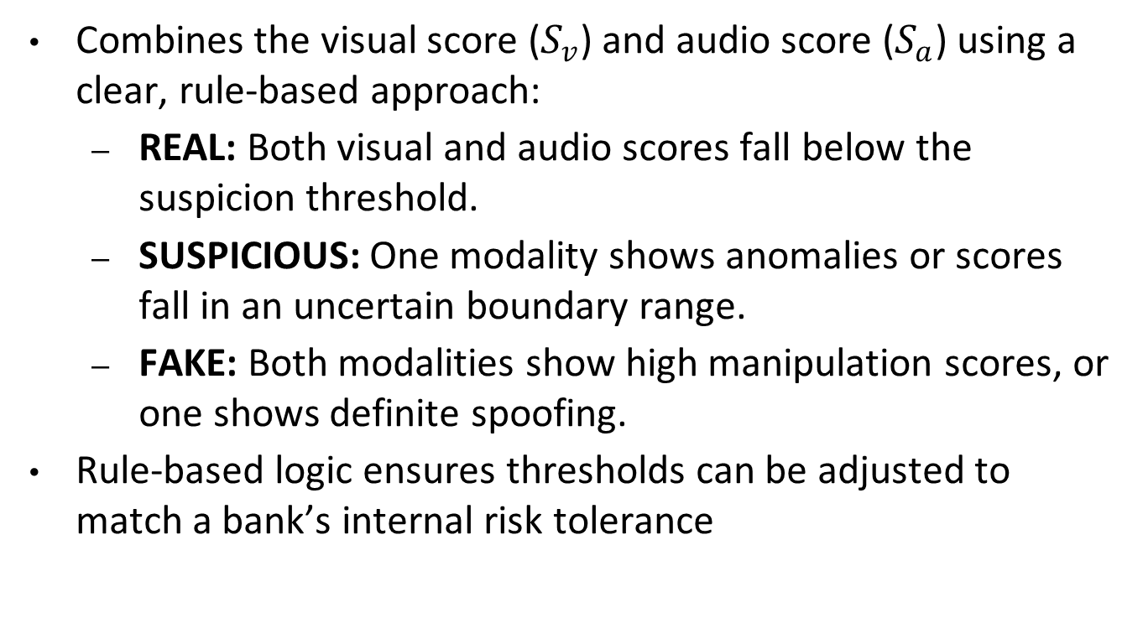
Fusion & Decision Logic
Combines the visual score ($S_{v}$) and audio score ($S_{a}$) using a clear, rule-based approach:
  REAL: Both visual and audio scores fall below the suspicion threshold.
  SUSPICIOUS: One modality shows anomalies or scores fall in an uncertain boundary range.
  FAKE: Both modalities show high manipulation scores, or one shows definite spoofing.
Rule-based logic ensures thresholds can be adjusted to match a bank’s internal risk tolerance

Slide 21
Forensic Reporting & Web Dashboard
Simple web dashboard designed for non-technical bank compliance officers.
Drag-and-drop file upload with progress tracking.
Immediate screen display of the final verdict: Real, Suspicious, or Fake.
Breakdown showing separate visual score, audio score, and flagged frame previews.

Slide 22
Audit Trail & Report Generation
Generates an official downloadable PDF verification report.
Includes session timestamp, applicant identifier, final verdict, and model scores.
Embeds the Grad-CAM explainability heatmap directly into the document.
Calculates a cryptographic content hash (such as SHA-256) of the video file to prevent record tampering.

Slide 23
Datasets & Evaluation Strategy
Visual Evaluation: Tested on standard benchmark subsets from FaceForensics++ and DFDC (Deepfake Detection Challenge).
Audio Evaluation: Tested on benchmark voice-spoof subsets from the ASVspoof dataset.
Metrics Tracked: Accuracy, Precision, Recall, and False Acceptance Rate (FAR).

Slide 24
PROJECT SCOPE

Slide 25
Project Scope – In Scope
Visual deepfake detection using pre-trained computer vision models.
Synthetic voice detection using pre-trained audio classification models.
Transparent rule-based fusion logic combining both scores.
Grad-CAM visual heatmaps for face manipulation.
Functional web dashboard for file upload and verdict display.
Downloadable PDF report containing a content hash.

Slide 26
Project Scope – Out of Scope
Real-time live camera stream interception during calls (works on recorded verification clips).
Training brand-new neural network architectures from scratch.
Direct database or API integration into live banking core production systems.
Dedicated native mobile applications (iOS/Android).

Slide 27
CONSTRAINTS AND LIMITATIONS

Slide 28
Constraints & Limitations
Compute Constraints: Model inference speed depends on available GPU/CPU hosting hardware.
Compression Impact: Heavily compressed video clips from low-bandwidth connections can degrade detection accuracy.
Near Real-Time Processing: Analysis takes a short processing interval rather than executing instantaneously.

Slide 29
Work Breakdown Structure

Slide 30
Work Breakdown Structure
Phase 1: Project Setup & Data Acquisition
  Define functional system requirements for bank KYC compliance.
  Collect and prepare benchmark evaluation datasets (FaceForensics++, DFDC subsets, and ASVspoof).
  Build the initial data-preprocessing pipeline for video and audio separation.
Phase 2: Module A – Visual Forensics Pipeline
  Video frame extraction and facial bounding box detection.
  Face cropping and normalization for classifier input.
  Integration and inference setup for pre-trained CNN backbones (e.g., EfficientNet / Xception).
  Grad-CAM implementation to generate facial manipulation heatmaps.
Phase 3: Module B – Audio Forensics Pipeline
  Audio track demuxing and conversion from MP4/AVI clips.
  Mel-spectrogram generation and feature extraction using Librosa.
  Integration of pre-trained synthetic speech/voice-clone detection model.
  Score normalization for acoustic manipulation likelihood.

Slide 31
Work Breakdown Structure
Phase 4: Fusion Engine & Decision Logic
  Design transparent, rule-based scoring logic combining visual and audio outputs.
  Calibration of classification thresholds (Real, Suspicious, Fake).
  Edge-case handling for missing audio channels or corrupted video frames.
Phase 5: Web Platform & Forensic Reporting
  Development of the KYC officer dashboard (file upload, progress monitor, results view).
  Heatmap display rendering for flagged frames.
  Automated PDF engine to compile visual evidence, metrics, and session details.
  SHA-256 cryptographic hashing for file integrity and tamper-proof audit trails.
Phase 6: Testing, Evaluation & Documentation
  Performance benchmarking against public test splits (accuracy, precision, recall, FAR).
  Mid-term and final project reports, code repository cleanup, and FYP defense prep.

Slide 32
Team Roles & Responsibilities
Sultan (56189):
  Visual Forensics pipeline (Module A)
  Grad-CAM explainability integration
  Backend API development and fusion logic implementation
Ch Mubashir (56892):
  Audio Forensics pipeline (Module B)
  Audio feature extraction (mel-spectrograms)
  Web dashboard user interface and PDF report generation engine

Slide 33
THANK YOU

